Slide 1
TOPIC -
FINDING CATARACT USING ARTIFICIAL INTELLIGENCE

Slide 2
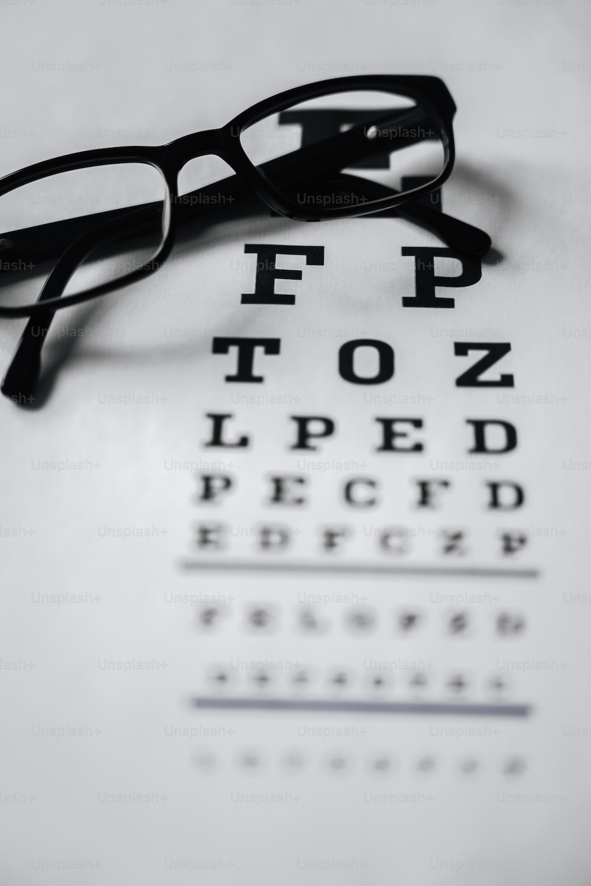
INTRODUCTION
The development of Eye Testing Apparatus using Artificial Intelligence (AI) for the detection of cataract has the potential to revolutionize the way we assess and diagnose visual impairments. This apparatus combines the precision of AI algorithms with the accessibility of digital devices to provide efficient and accurate eye testing.

Slide 3
OBJECTIVE
To develop a user-friendly, accurate, and accessible solution for eye testing
Develop a user-friendly interface that allows individuals to undergo the eye testing process with minimal guidance

Slide 4
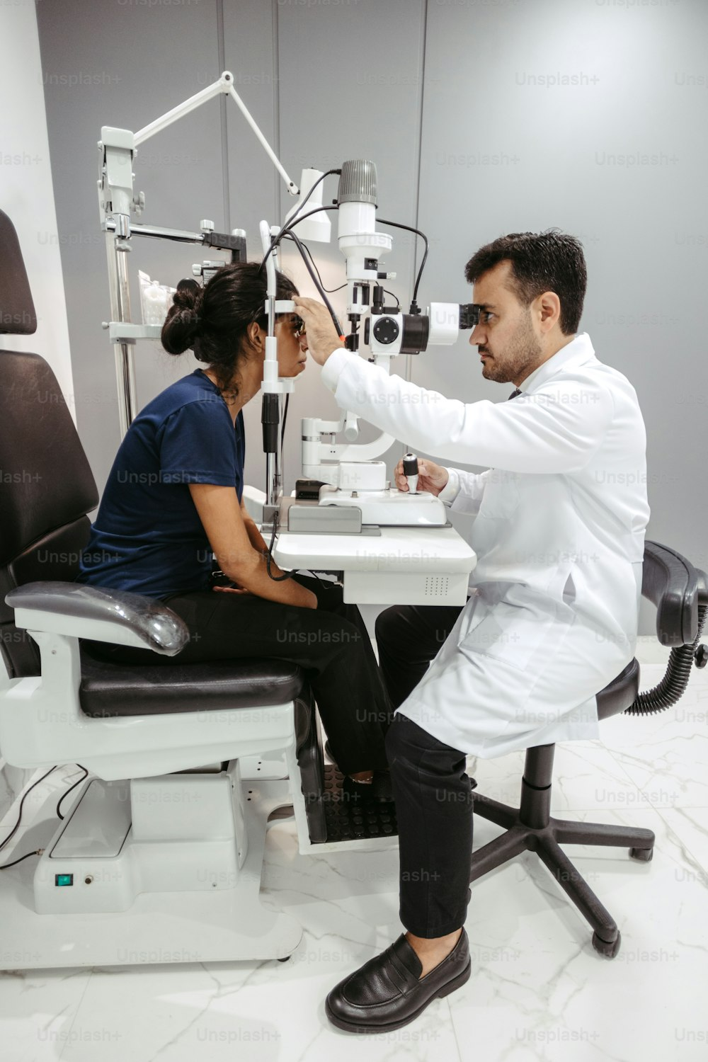
DETAILED ANALYSIS
The AI algorithm that we have developed can assess cataract.
It can detect cataract in both the left eye as well as the right eye.
It gives instant results including position, size, cloudiness ratio, and cataract detection status, is presented in a structured format along with a bar chart showcasing edge areas.

Slide 5
Description of Work done
The apparatus combines hardware components with intelligent software to create a user-friendly and accurate tool for eye testing.
We made our code using Python
REQUIREMENTS
The user should have a laptop and webcam and run the code to check for cataract detection

Slide 6
First the AI in the program detects the user’s face, then the right and left eye. After that it gives the result that in which eye the user has cataract or not. Live Webcam Capture • The Python module OpenCV access's the live video feed from the webcam, allowing interaction with the user. • The user can capture a still image by pressing the spacebar, providing a user-friendly experience.
PROCESS IN DETAIL

Slide 7
Face and Eye Detection:
Cutting-edge Haar cascade classifiers are used for accurate face and eye detection in the captured image.
The algorithm identifies multiple faces within the frame and differentiates the regions corresponding to each detected eye.
Eye Analysis:
For each detected eye, the script applies the Canny edge detection algorithm to reveal the small details.
Cloudiness ratio, indicative of potential cataracts, is computed based on the edge area relative to the total eye region.

Slide 8
Cataract Detection Results:
The script provides a detailed visual representation of the analysis by generating a bar chart showcasing the edge areas of all detected eyes.
Detailed information for each eye, including position, size, cloudiness ratio, and cataract detection status, is presented in a detailed format.
User Interaction and Output:
The application incorporates user interactions, allowing for image capture and script termination using simple keyboard inputs (spacebar and escape key).
Results are presented interactively through both printed information and visualizations, adding to a better user experience.

Slide 9
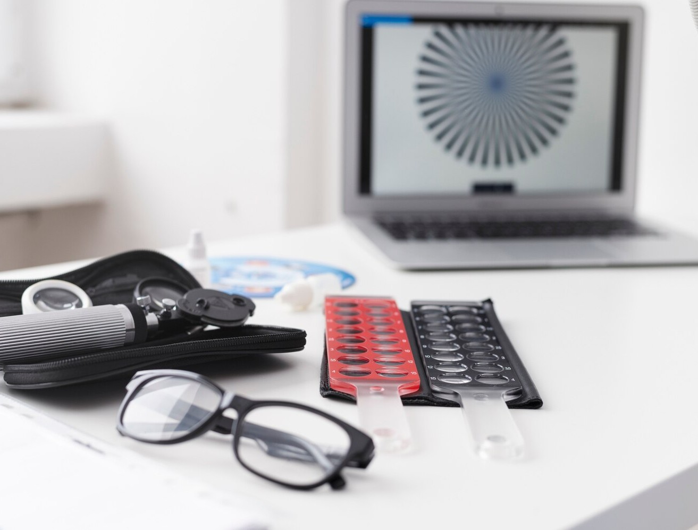
ADVANTAGES OF THE APPARATUS
The integration of AI algorithms contributed to precise measurements comparable to traditional testing methods.
User-Friendly Interface
Ease of access.

Slide 10
OUTCOME
Real-Time Feedback:
Users receive immediate feedback on potential cataract presence, enabling timely intervention.
Quantitative Measures:
The script provides quantitative measures, such as cloudiness ratio and edge area, offering better understanding of cataract likelihood.

Slide 11
User friendly Interface:
The user interface was found to be intuitive and accessible to individuals. Clear instructions and interactive elements guided users through the testing process effectively.
Adaptability and Customization:
The ability to adapt to different lighting conditions contributed to the reliability of results.

Slide 12
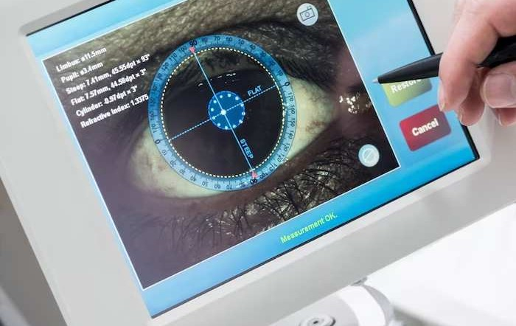
Conclusion:
The Eye Testing Apparatus we have made particularly focused on cataract detection.The user-friendly interface and adaptability of the system makes it accessible to a broad range of users, including those in remote or underserved areas. Further research and real-world implementation will be crucial to validate and optimize the apparatus's performance in diverse healthcare settings.Detecting cataracts early not only ensures timely intervention but also contributes to a broader public health initiative in combating preventable blindness.

Slide 13
MADE BY – NAKUL 2401730184 PRANAV 2401730161 HARSH 2401730174 DEVANSH 2401730127

Slide 14
THANK YOU

